Slide 1
How to Build an Industry Cost Profile (ICP) for a product in Malaysia
Select the Industry Code Based on the Supplier’s Business and Product
Step 2
Identify Data Sources for Financial and Manufacturing Information Related to Industry Code
Step 3
Use Financial Data to Calculate Ratios for COGS, PBT, GSA & Other Expenses
Step 4
Use Manufacturing Data to Calculate Ratios for DM, DL, and MOH
Step 1

Slide 2
Select the Industry Code Based on the Supplier’s Business and Product
Step 1
1. Go to:
and click below “MSIC DESCRIPTION”
2. Search product or service of interest – for our example we will use Manufacture of Plastic Products - 2220
msic.stats.gov.my/bi/

Slide 3
Identify Data Sources for Financial and Manufacturing Information Related to Industry Code
Step 2
Malaysian government economic statistics are found at:
Financial data of companies can be found at:
Additionally, we will use Economic Statistics from India as a proxy to estimate direct labor ratios
 | Direct Material (DM)
 | Direct Labor (DL)
 | Manufacturing Overhead (MOH)
 | Cost of Goods Sold (COGS)
 | GSA & Other Expenses
 | Profit Before Tax (PBT)
 | Total Sales
https://www.dosm.gov.my/v1/
Manufacturing data
Source: Malaysia Department of Statistics
Financial data
Source: Financial reports of companies
google.com/finance
*You will use these data sources to express DM, DL, MOH, COGS, GSA & Other Expenses and PBT as ratios, in the form of percentages of Total Sales.

Slide 4
Use Financial Data to Calculate Ratios for COGS, PBT, GSA & Other
Step 3
From each firms’ Income Statement, use multiple year averages to calculate COGS, GSA & Other Expenses and PBT.
Use as many firms as you judge necessary to get an accurate representation of the industry you are modelling.
Core Molding Technologies (CMT)*
 |  | 2020 | 2019 | 2018 | Average
 | COGS | 75.5% | 76.1% | 74.0% | 75.2%
 | GSA & Other | 18.4% | 18.6% | 19.1% | 18.7%
 | PBT | 6.1% | 5.3% | 6.9% | 6.1%
 | Total Sales | 100% | 100% | 100% | 100%
*Example firm operating in the Plastics Product Manufacturing Industry
$$COGS \%=\frac{COGS}{Total Sales}$$
$$PBT \%=\frac{PBT}{Total Sales}$$
GSA & O. Exp. % = Total sales (100%) – COGS % – PBT %

Slide 5
Use Financial Data to Calculate Ratios for COGS, PBT, GSA & Other
Step 3
Average the ratios of the selected firms to create your industry ratios
Selected firms in Plastics product manufacturing industry*
 |  | Firm 1 | Firm 2 | … | Firm 7 | Average
 | COGS | 75% | 79% | … | 76% | 77.6%
 | GSA & Other | 19% | 17% | … | 19% | 17.8%
 | PBT | 6% | 4% | … | 5% | 4.6%
 | Total Sales | 100% | 100% | … | 100% | 100%
*Example data for illustration purposes only

Slide 6
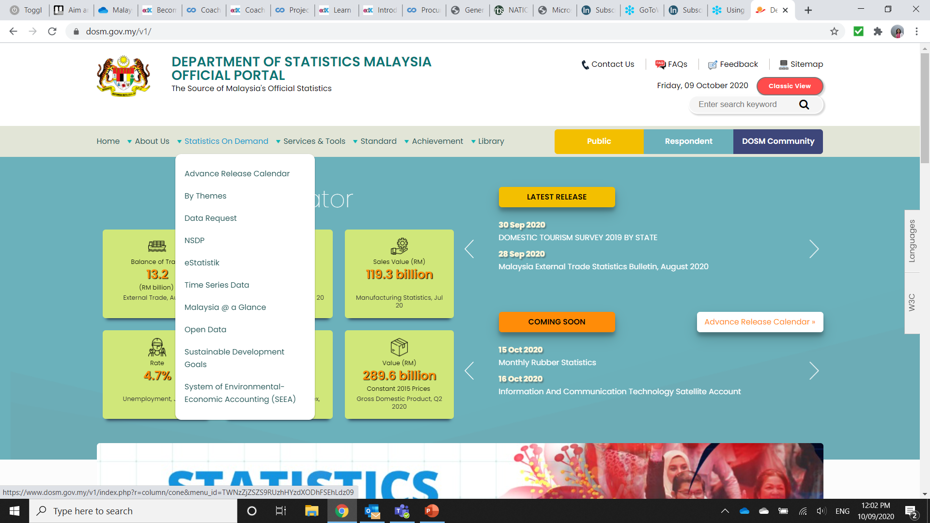
Use Manufacturing Data to Calculate Ratios for DM, DL, and MOH
Step 4
In Malaysia, follow 13 steps to find DM, DL, and MOH.
Step: 1-2
1. Go to:
and click:
“Statistics On Demand”
2. Click ‘eStatistik’ link
https://www.dosm.gov.my

Slide 7
Use Manufacturing Data to Calculate Ratios for DM, DL, and MOH
Step 4
Steps: 3 – 4
3. Register for a User ID and Password
After receiving your login details, come back to this page and click ‘Free Download’
3.
4.

Slide 8
Use Manufacturing Data to Calculate Ratios for DM, DL, and MOH
Step 4
Steps: 5 – 6
5. Under Free Download, select ‘Economy’ under main category and ‘Manufacturing’ under sub-category. Then select the ‘Search’ button
6. Scroll through the list of reports and locate the most recent ‘Report on Annual Survey of Manufacturing industries, Malaysia’

Slide 9
Use Manufacturing Data to Calculate Ratios for DM, DL, and MOH
Step 4
7. Extract “Value of gross output” and “Salaries & wages paid” from Table 2 for the applicable industry

Slide 10
Use Manufacturing Data to Calculate Ratios for DM, DL, and MOH
Step 4
8. Extract ‘Cost of Raw Materials’ data from Table 8 for the industry

Slide 11
Use Manufacturing Data to Calculate Ratios for DM, DL, and MOH
Step 4
Steps: 9
9. Calculate the DM ratio as percentage of Gross Output (We use this value for Total Sales)
9.
 | Cost of raw materials | 17,697,529
 | Value of Gross Output | 28,857,370
 | Direct Material (DM) | 61.33%

Slide 12
Use Manufacturing Data to Calculate Ratios for DM, DL, and MOH
Step 4
Steps: 10
10. Use the India Ministry of Statistics to calculate the Direct Labor to Total Labor ratio
See the procedure:
10.
Direct-to-Total Labor Ratio from India

Slide 13
Use Manufacturing Data to Calculate Ratios for DM, DL, and MOH
Step 4
Steps: 11 – 12
11. Apply the Direct to Total Labor ratio to ‘Salaries & wages paid’ to obtain an estimate of Direct Labor cost
12. Use the Direct Labor cost to calculate the Direct Labor Ratio
 | Salaries & Wages Paid | 3,367,498
 | Direct to Total Labor ratio | x 51.50%
 | Direct Labor Cost | 1,764,261
 | Direct Labor Cost | 1,764,261
 | Value of Gross Output | 28,857,370
 | Direct Labor Ratio | 6.01%

Slide 14
Use Manufacturing Data to Calculate Ratios for DM, DL, and MOH
Step 4
Steps: 13
13. Calculate MOH by deduction as follows:
 | Cost of Goods Sold (COGS) | 77.60%
 | less Direct Material (DM) | 61.33%
 | less Direct Labor (DL) | 6.01%
 | Manufacturing Overhead (MOH) | 10.26%
13.
MOH = COGS – DM –DL

Slide 15
Present all your calculated ratios in the cost breakdown format
Industry cost profile for “Plastics product manufacturing”
 | Direct Material (DM) | 61.33%
 | Direct Labor (DL) | 6.01%
 | Manufacturing Overhead (MOH) | 10.26%
 | Cost of Goods Sold (COGS) | 77.60%
 | GSA & Other Expenses | 17.80%
 | Profit Before Tax (PBT) | 4.60%
 | Total Sales | 100.00%
Ratios calculated from Department of statistics Malaysia
Ratios calculated from companies’ financial data

Slide 16
References and summary of ICP calculations
Cost Element | % of Sales | Calculation | Order
DM | 61.33% | = E / F | 4
DL | 6.01% | = (C * D) / F | 5
MOH | 10.26% | = COGS - DM - DL | 6
COGS | 77.60% | = A | 1
GSA | 17.80% | = Total - COGS - PBT | 3
PBT | 4.60% | = B | 2
TOTAL | 100.00%
SUMMARY OF DATA
 | Data point | Value | Source
A | Cost of Goods Sold | 77.60% | Average of representative firm's financials
B | Profit Before Tax | 4.60% | Average of representative firm's financials
C | Salaries and wages paid | 3,367,498 | Report on Annual Survey of Manufacturing industries, Malaysia: Code 222
D | Direct Labor / Total Labor ratio | 51.50% | India Annual Survey of Industries
E | Cost of raw materials | 17,697,529 | Report on Annual Survey of Manufacturing industries, Malaysia: Code 222
F | Value of Gross Output | 28,857,370 | Report on Annual Survey of Manufacturing industries, Malaysia: Code 222

